Slide 1

project for Software engineering Course 2018/19
Notes:
Typical intro

Slide 2
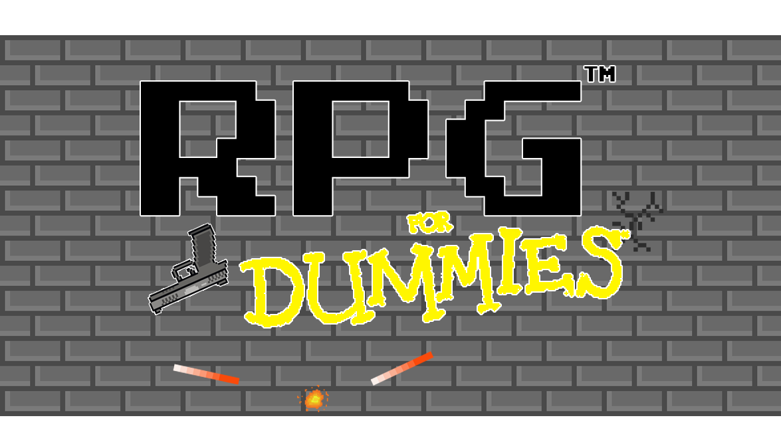
Notes:
Auto-explain

Slide 3
Group components:
Fernando Manna
Giovanni Di Prisco
Marco Schettini
Mario Mupo
Sergio Siniscalchi
Ascanio Guglielmelli
Romeo Rinaldi
Notes:
Group organization

Slide 4
Genre
The game is a 2-D shooter with an RPG component
Notes:
2D shooter retro-game
RPG
Possibility to shoot around the scenario without using the mouse

Slide 5
Character
At the start of the game it is possible to choose a character and a name which will identify him during the game
Notes:
As we’ll have the possibility to set some game options (audio), in a main menu we’ll have the possibility to customize the character (aspect/name)
Thanks to a in-game interface , the player is able to check character’s stats anytime.

Slide 6
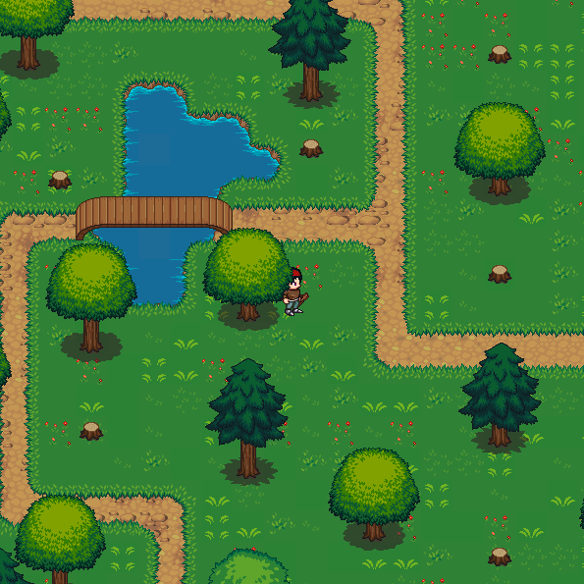
Scenario
The setting is based on a top-down perspective and each room is seen as a rectangle containing obstacles and enemies
Notes:
The game is based on a top-down perspective.
The player will have the possibility to move the character freely without jumping on any platform, so exploring rooms and avoiding obstacles.

Slide 7
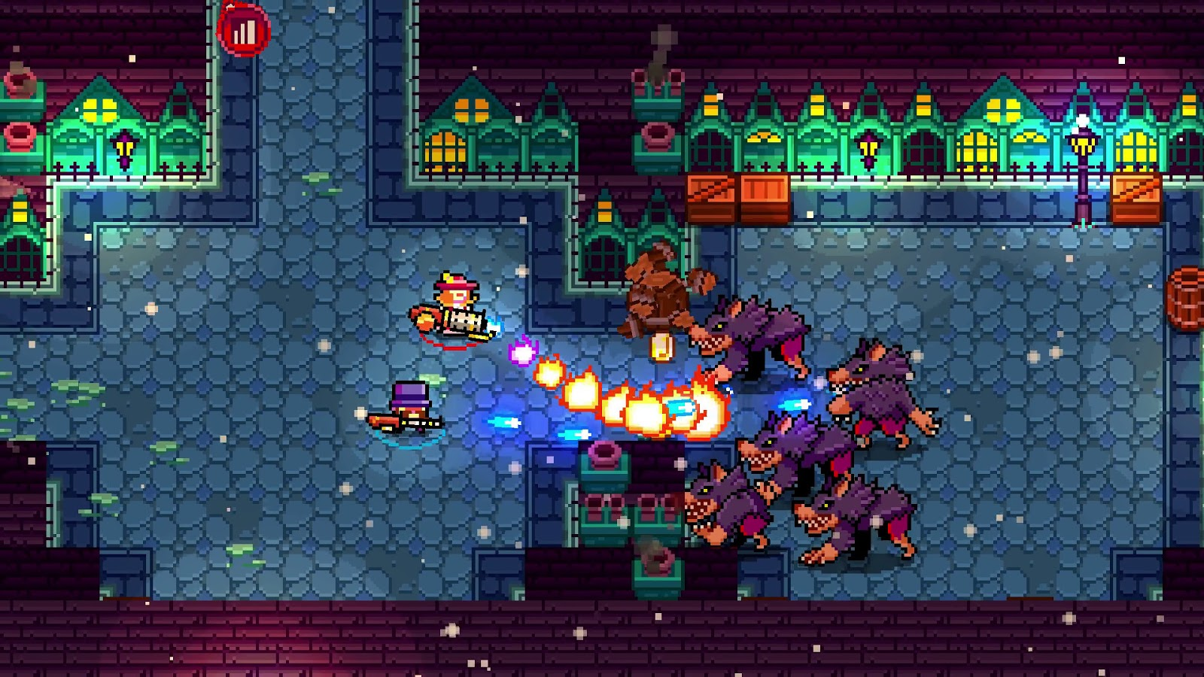
Modes
More possible game modes will be present.
Designed Modes:
Dungeon
Time Survival
Boss Rush
….
Notes:
The player will have the opportunity to benefit from different playstyles and different game modes.
Choosing them, the player can customize his game experience.
With game mode we intend the type of the gameplay, for example:
Dungeon stands for a game in which you can level up only by completing the planned actions,
The boss rush differs from the Dungeon because of the presence of an only enemy difficult to beat
So, time survival mode aims to complete the planned actions in a certain amount of time
…
Then, an increasing difficulty system makes more challenging the game, from level to level.

Slide 8
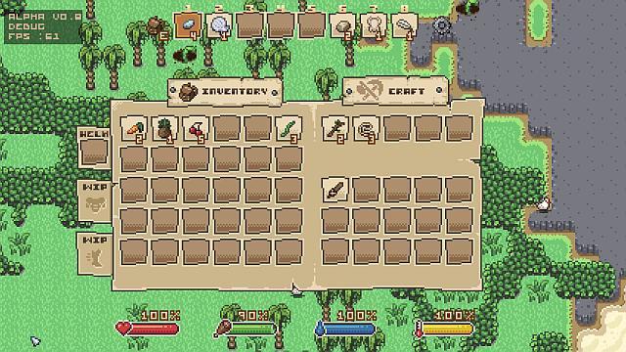
features
The game features RPG components including crafting and the ability to collect useful items to create a build that can improve the statistics of your character
Notes:
The character will be able to collect items and fight enemies shooting at them, collecting their rewards.
The character will benefit from power-ups and a crafting system, so the player will be able to improve equip and items, or craft new ones.
It’s planned a main room to store in safely. In this room the player will be able to manage equipment, items, power-ups and crafting, or save progresses

Slide 9
Conclusions
All images seen are not present in the game, they are used only as examples

